Slide 1
In-class Exercise 09 - Connected Component Labeling
Dhiren Gupta
-800902466

Slide 2
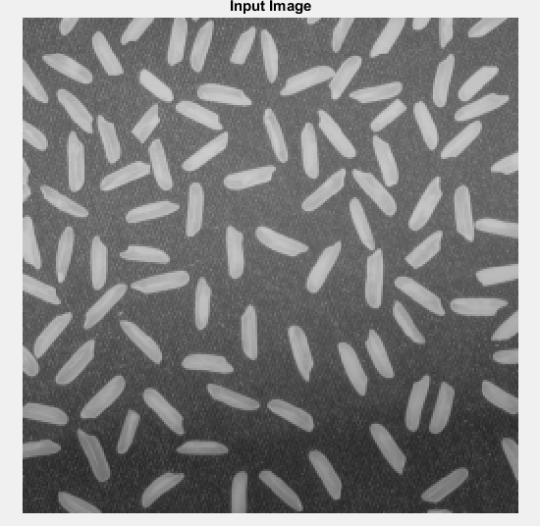
Input Image

Slide 3
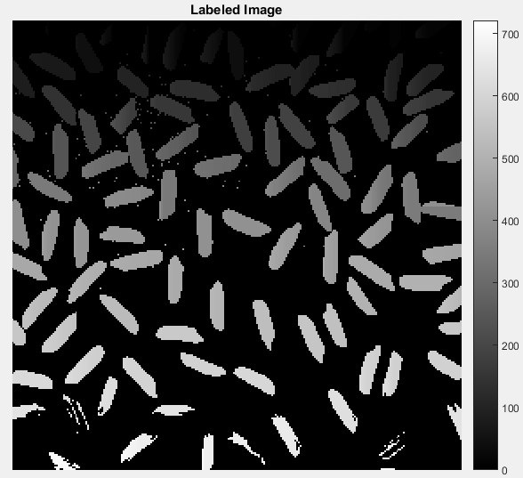
Labeled Image

Slide 4
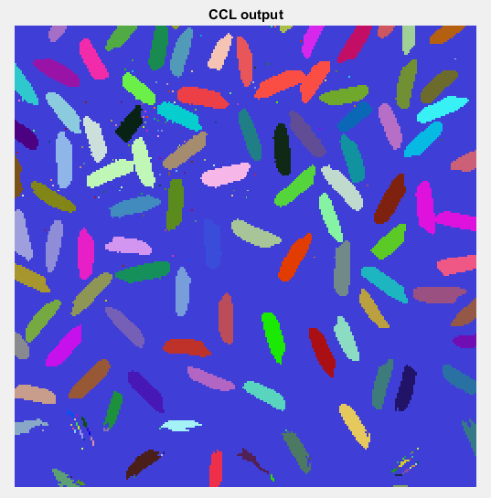
CCL- Output Image

Slide 5
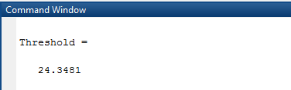
Threshold Value

Slide 6
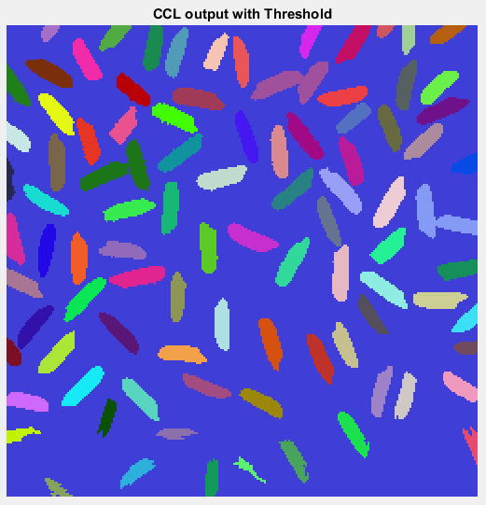
CCL with Threshold-Output iamge

Slide 7
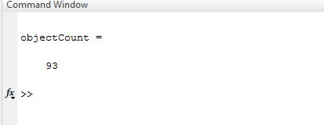
No of objects after threshold

Slide 8
Thank You

